Slide 1
Sample #8
180 mBar; 750°C; scratched
First position

Slide 2
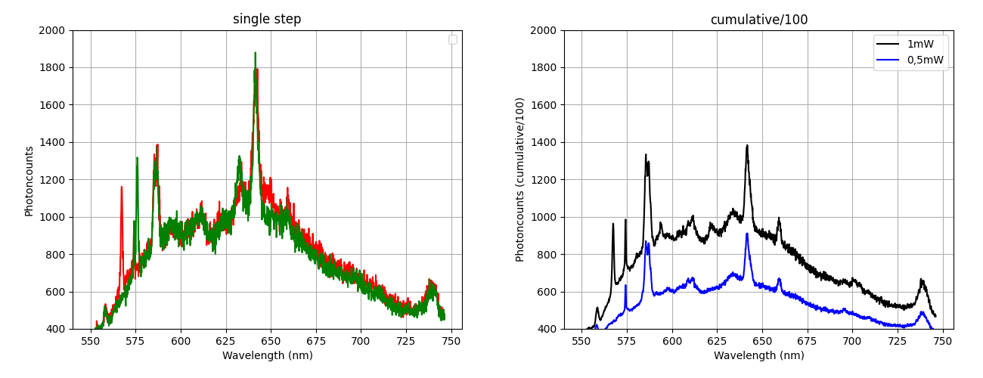

Sample #8
First iteration

Slide 3
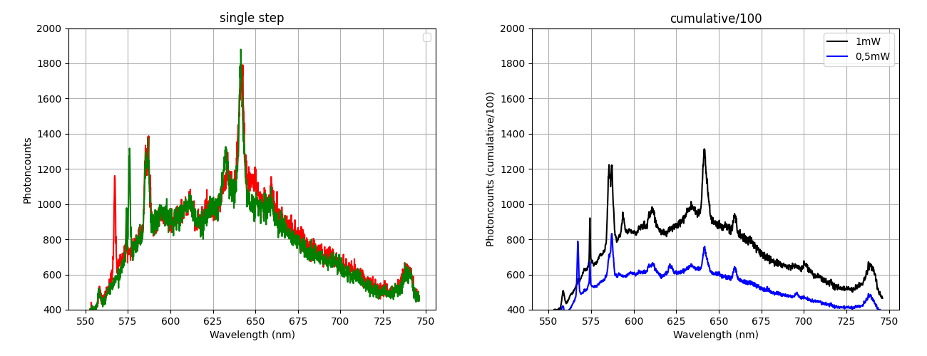
Sample #8
Second iteration

Slide 4
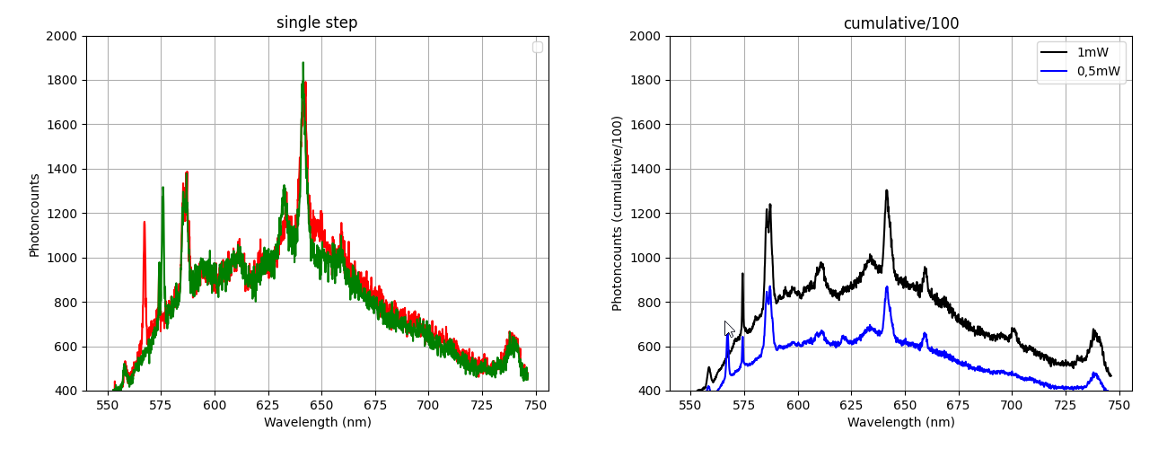
Sample #8
Third iteration

Slide 5
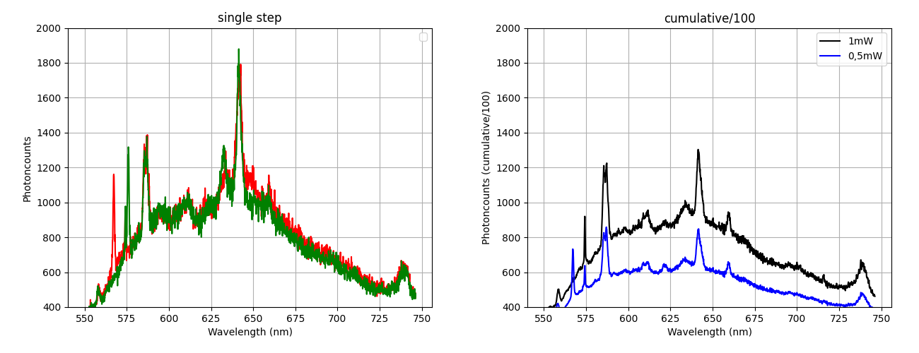
Sample #8
Fourth iteration

Slide 6
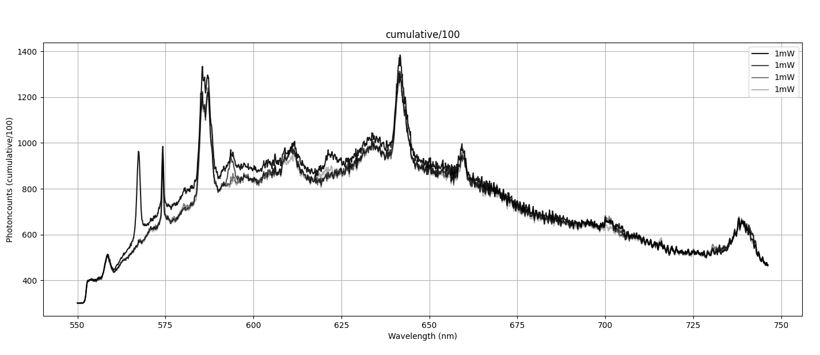
Sample #8
Decay?

Slide 7
Sample #8
180 mBar; 750°C; scratched
Second position

Slide 8
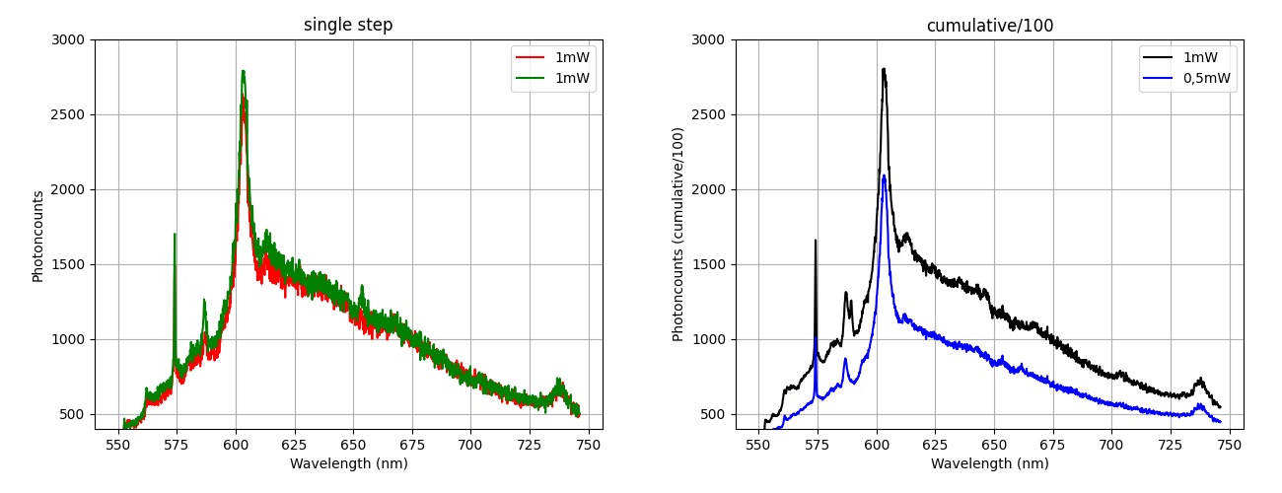
Sample #8
First iteration

Slide 9
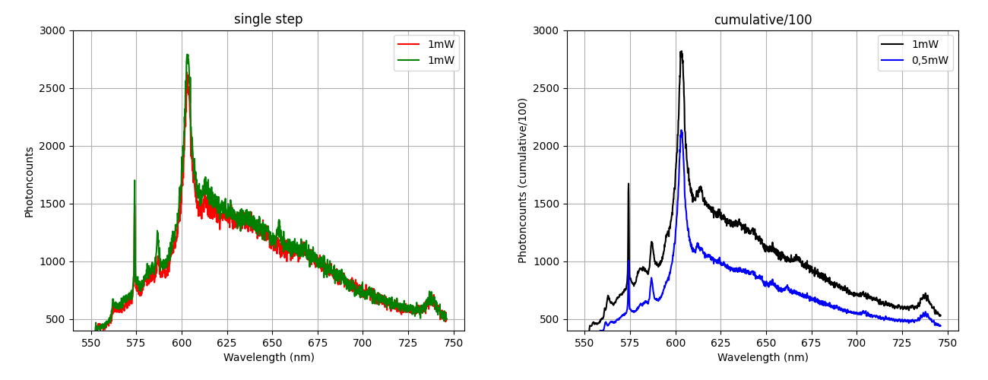
Sample #8
Second iteration

Slide 10
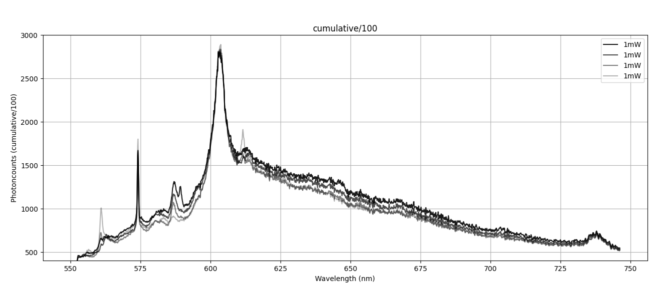
Sample #8
Decay?

